Slide 1
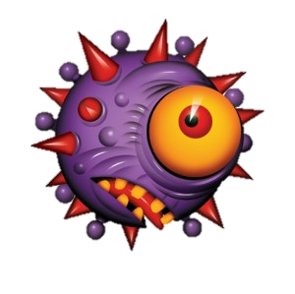
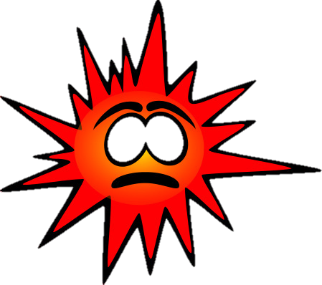
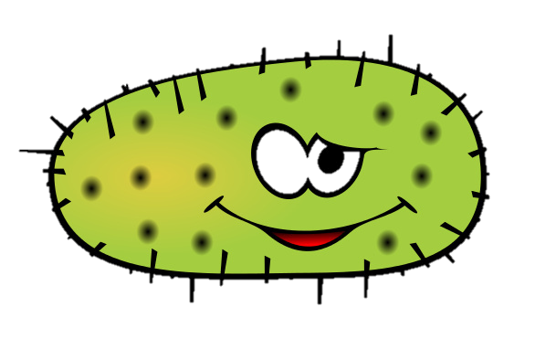
Microbes
LO: To be able to explain how the two types of microbe cause illness (L6).
Starter: Draw an outline of a human body and label how microbes get into our bodies. Extension: list some common illnesses that are caused by microbes.

Slide 2
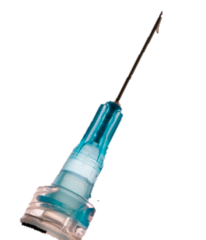
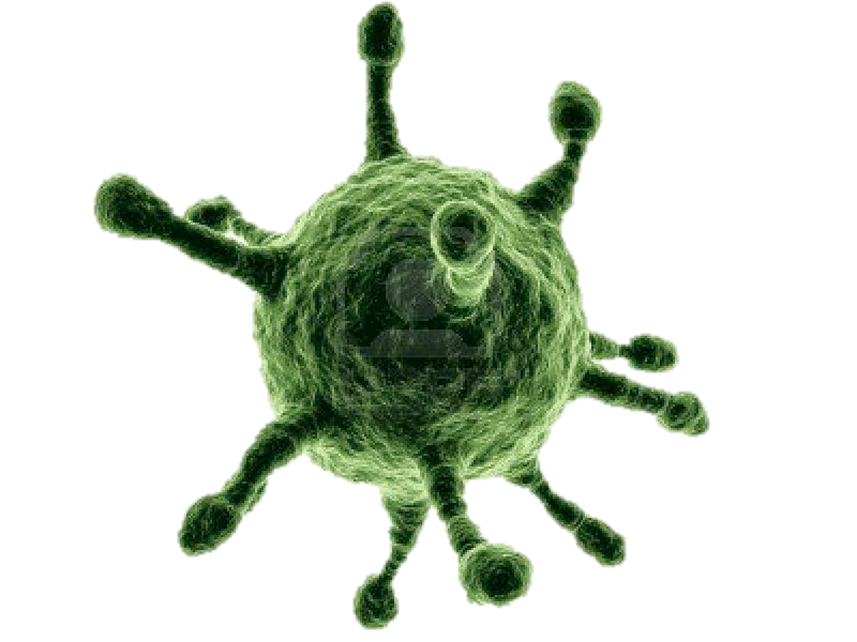
Topics covered:
Microbes (pathogens, bacteria and viruses)
Bodily defence systems (natural defences)
Immune System (+ white blood cells)
Vaccination (+ Autism & Deadly Diseases)
Antibiotics (+ MRSA)

Slide 3
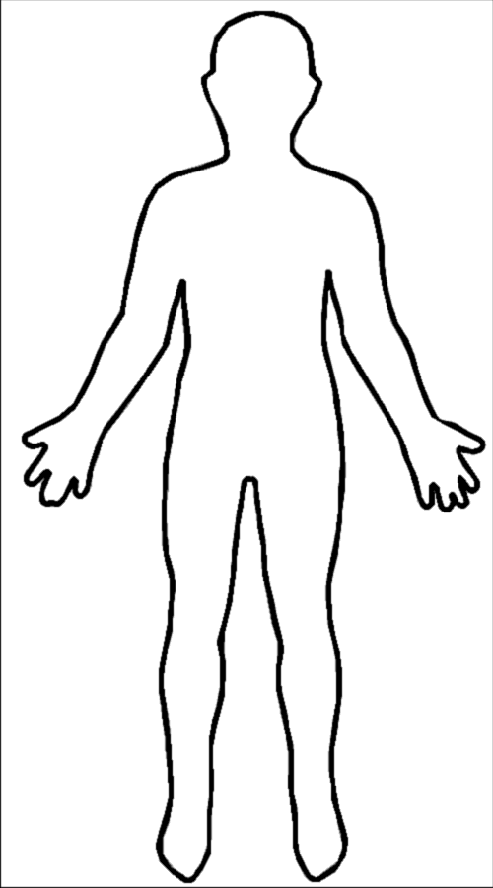
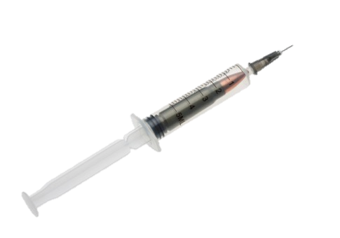
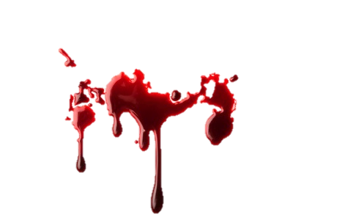
Starter
Eyes, ears, mouth and nose!
Intravenous drug use and vaccination
Through open wounds, cuts, grazes and blisters
Sexually transmitted through bodily fluids

Slide 4
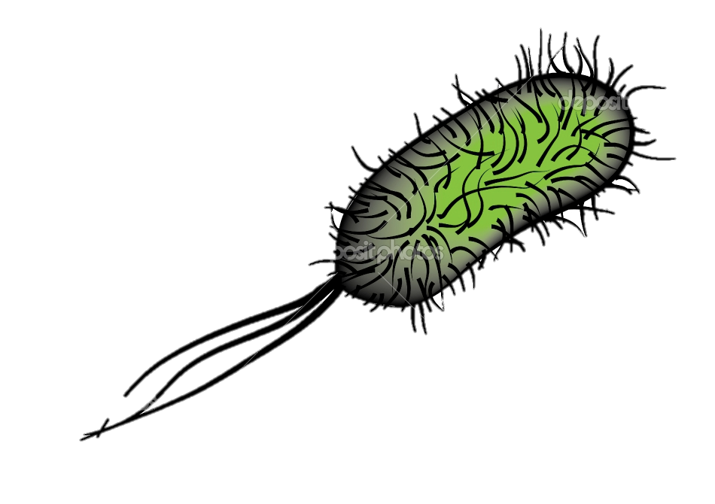
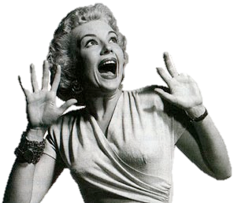
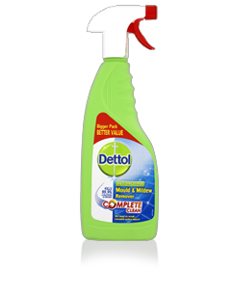
Common Microbes
Microbe is the name given to viruses and bacteria. Pathogen is the name given to viruses and bacteria that cause infection and illnesses.
Should we be scared of all microbes?

Slide 5
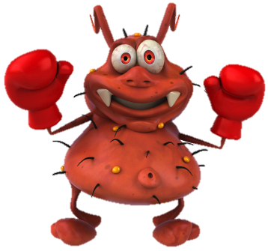
Bacteria Vs. Viruses
Timer
Around the room are various information stations on bacteria and viruses. You have 5 minutes to collect as much information as you can on bacteria and viruses. Work in pairs!
Now share your information with your partner and the rest of your table.

Slide 6
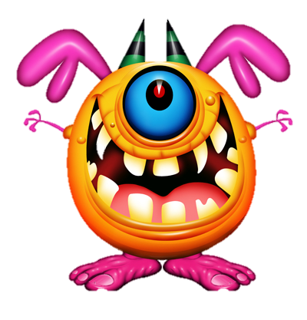
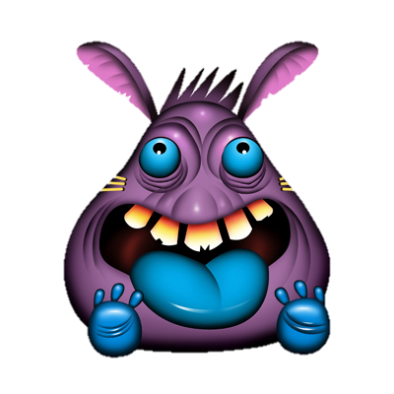
Creating Symptoms
With a partner create a description of how bacteria and viruses create symptoms.
Bacteria Cause Symptoms by…
Viruses Cause Symptoms by…
Keywords: Reproduce – inside cell – burst out – multiply – toxins – pathogen – destruction – immune response – blood stream – symptoms – illness.

Slide 7
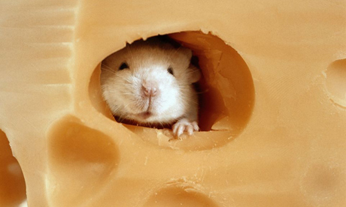
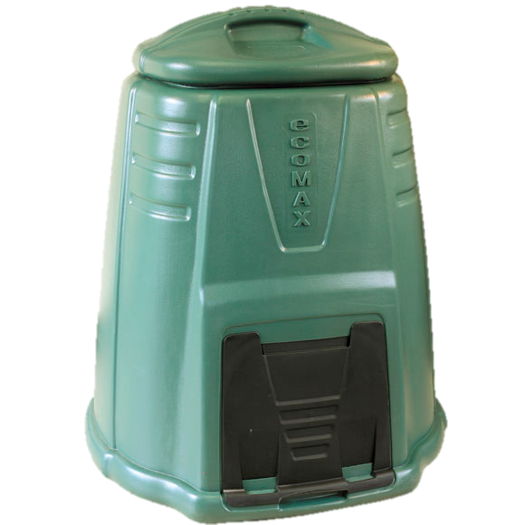
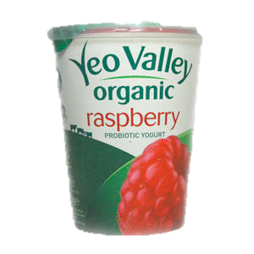
Good Microbes..?
There are a lot of very helpful and useful bacteria that do us good!
Without me this yoghurt wouldn’t be possible to make.
Not all microbes are bad!
My friends and I help break down garden waste into compost.

Slide 8
Bodily Defense
LO: To be able to explain what defence systems human beings have against infection and invasion of pathogens.
Last lesson we learnt how microbes got into miserable Michelle’s body…
Starter
What does miserable microbe Michelle have to help prevent microbes and pathogens enter her body?
What does her body do to keep bacteria and viruses on the outside of the body?

Slide 9
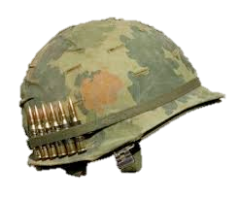
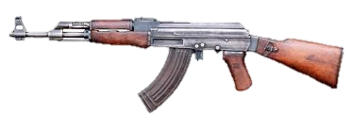
Miserable Microbe Michelle
Michelle is going to war with microbes and pathogens. She has the following NATURAL weapons and systems available to her!
Skin
Tears
Eyelashes
Ear Wax
Snot & Bogeys
Eye lids
Immune System
White Blood Cells
Clotting & Scabs
Ciliated Cells
Vaccination

Slide 10
Defence System Analyst
Find some group members (3-4 in a group).
Read through the mission brief.
Analyse the pathogen intelligence report.
Devise a bodily defence strategy against the possible threat of pathogen attack.

Slide 11
Work with parent/Mum
As a baby you will have had a certain number of vaccinations. As a young person you will still receive some more vaccinations, especially if you visit some remote countries.
What vaccinations have you received? Research the diseases that you have been vaccinated against.

Slide 12
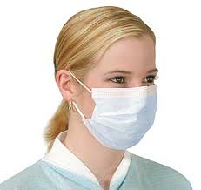
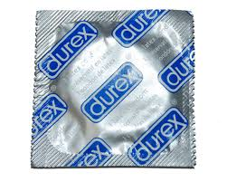
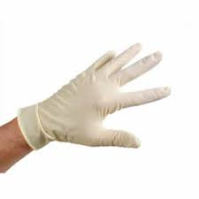
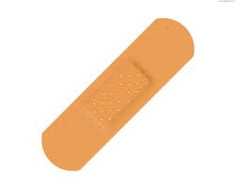
Plenary
Non natural defence systems:
We can use some ‘non natural’ systems to help us defend against microbes and pathogens.
What could they be?

Slide 13
Immune System
LO: To be able to describe how the immune system works.
Last lesson we learnt how miserable microbe Michelle dealt with some pathogens.
Starter
Unfortunately for Michelle, some pathogens have got past all of her natural defences and now it is up to the immune system to stop her from dying!
Explain what you think immune system means…

Slide 14
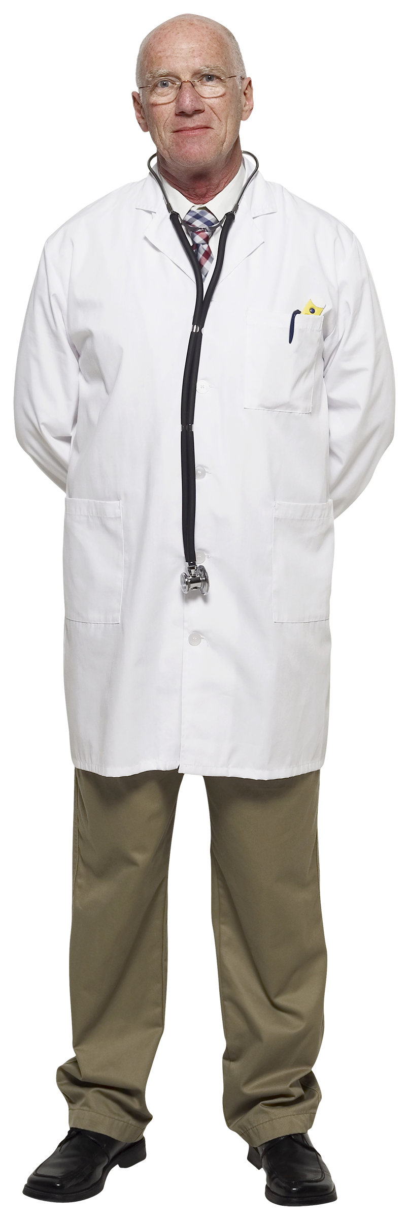
Natural Vs. Acquired Immunity
Your natural immunity is what you gained from your mother through her blood and through being breast fed. You also boost your natural immune system by eating worms and catching colds.
An acquired immunity is one that is given by vaccinations such as the MMR, Pfizer Bio-N-Tec for COVID-19

Slide 15
The Immune System
The human immune system is made up from different types of white blood cells.
Each white blood cell has a different job to do and they work in various stages.

Slide 16
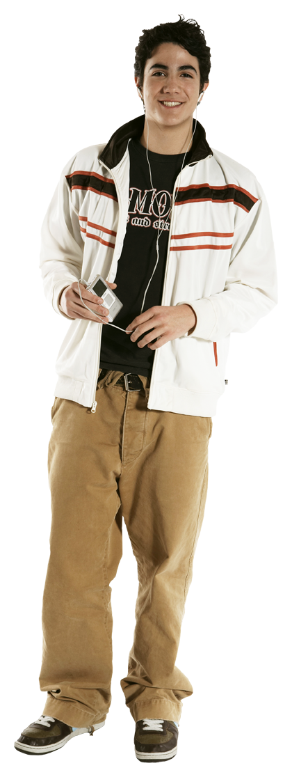
White Blood Cells
Can you find the right white blood cell for each job?
Looking for a big cell capable of producing antibodies
Cell needed to remember specific shapes and sizes quickly.
Are you hungry for pathogens? Do you have a big appetite? Apply Now!!!
Memory T Cell Phagocyte Lymphocyte

Slide 17
Assessed Task
Imagine you are a pathogen entering the body! You are new to the body and therefore the immune system doesn’t recognise you. Make a cartoon strip about the different stages of the immune system at work.
Success Criteria:
Have included all stages.
Have explained what has happened if the pathogen is recognised by the immune system
Have named the different white blood cells.

Slide 18
Plenary
HIV: The human immunodeficiency virus is a complex and debilitating disease. So far we do not have a cure for HIV. HIV weakens the immune system. HIV can lead to AIDS which is ‘acquired immune deficiency syndrome’. This means that the immune system stops working and catching a cold could end up killing a person with AIDS. HIV is found in the body fluids of an infected person, which includes semen and vaginal fluids, blood, inside the anus and breast milk. HIV and aids is inherited from infected mothers.

Slide 19
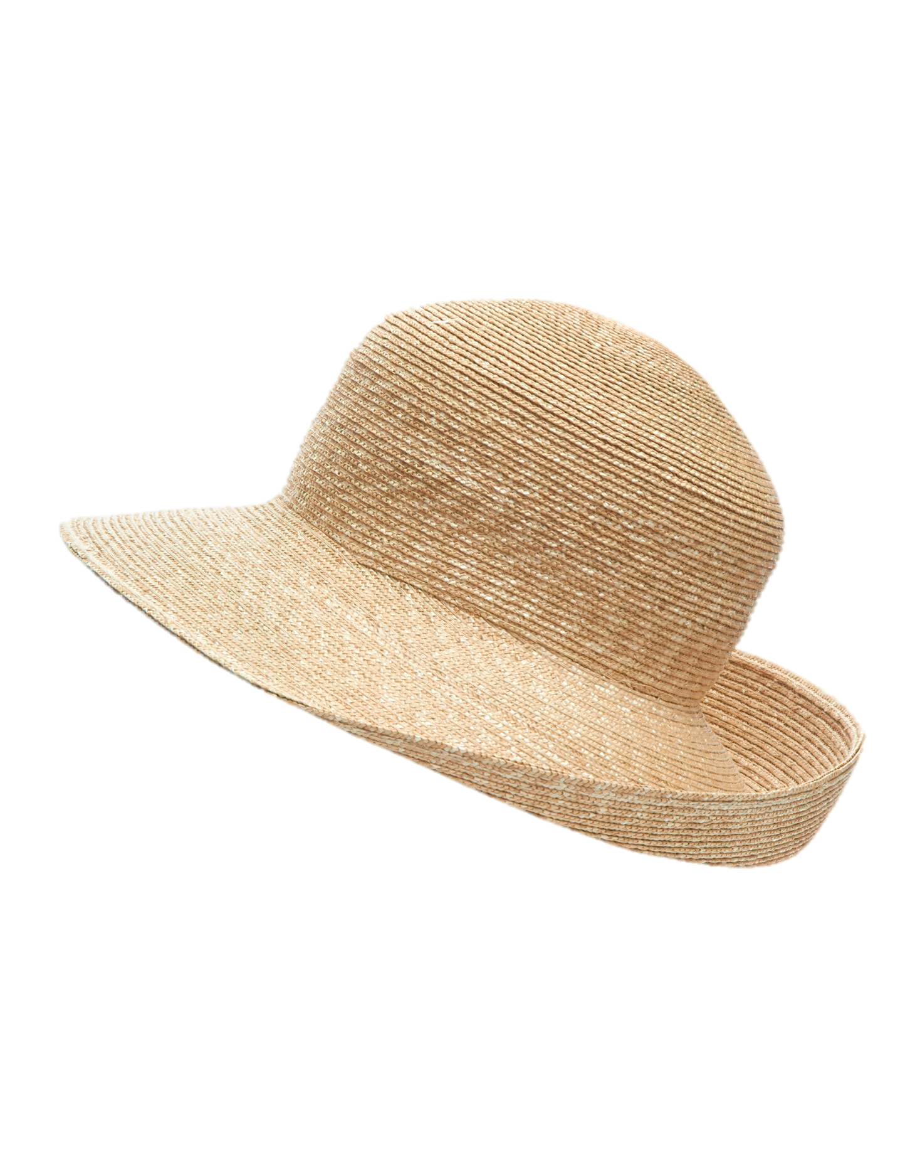
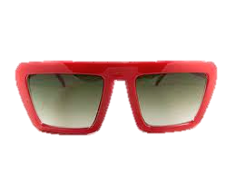
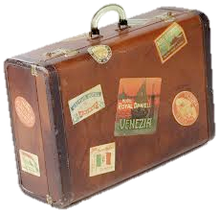
Vaccination
LO: To be able to explain how vaccination works.
Last lesson Microbe Michelle survived a pathogen attack…
Starter
Now Miserable Michelle is planning a holiday with her boyfriend Mad Mark, list some diseases she may need to be vaccinated against.

Slide 20
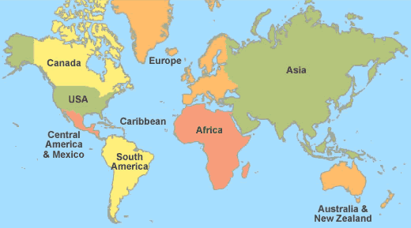
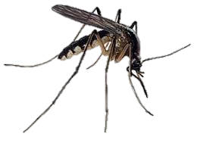
Some Nasty Worldwide Diseases
Yellow Fever
Typhoid
Hepatitis B
Worldwide
Malaria
Worldwide
Why are mosquitos the most hated flies in the world?

Slide 21
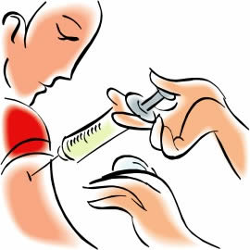
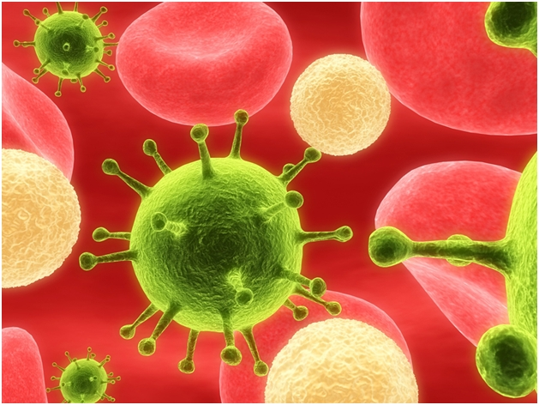
Vaccination
Vaccination is a preventative measure to protect you from some fatal and nasty diseases.
A vaccination is usually an injection that contains a weak, inactive or dead version of the disease that you are being vaccinated against.
Red Blood Cell
Pathogen
White Blood Cell

Slide 22
Vaccination Keywords
Can you define the following keywords?
Extension: can you arrange them in an order of how vaccination occurs.
Pathogen
Immunity
Injection
Antibodies
Antigens
White Blood Cells
Response
A microbe that causes disease.
The name given to your bodies protection against certain diseases.
A method of inserting a vaccination.
Produced by plasma cells that identify and destroy foreign microbes.
A unique shape on a virus or a bacteria.
Part of the immune system used to fight infection.
The name given to a process of white blood cells identifying foreign microbes.
Video – How Vaccines Work

Slide 24
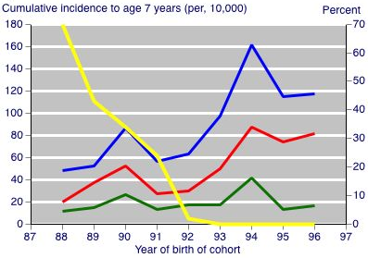
Plenary
In 1998 the respected medical journal ‘ The Lancet’ published a report by Dr. Andrew Wakefield. Wakefield proposed a link between autism and the MMR jab. Look at this graph and write down 3 statements that prove he was wrong.
Key
Yellow Line = MMR Vaccination % of population
Blue Line = All Autistic Spectrum Disorders
Red Line = Autism
Green Line = Regression

Slide 25
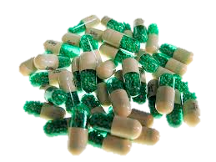
Antibiotics
LO: To learn how and why antibiotics should be used.
Starter
Last lesson Microbe Michelle had some vaccinations!
Unfortunately mad Mark died from Rabies on holiday but Michelle is still alive. She has however contracted a horrible bacterial infection.
Explain some differences between bacteria and viruses.

Slide 26
Viruses Vs Bacteria
Bacteria are microscopic organisms. They come in many shapes and sizes, but even the largest are only 10 micrometres long - 10 millionths of a metre, but they are bigger than a virus. Bacteria can be infected by viruses where they will replicate inside the bacteria.
Bacteria are living cells and, in favourable conditions, can multiply rapidly. Bacterial cells reproduce by a process called binary fission (simple splitting).
Once inside the body, they may release poisons or toxins that make us feel ill. The toxins from the waste products of bacteria are carried around the body in the blood. This is why you may feel tired and generally unwell in your whole body rather than the specific site of infection.
Viruses are many times smaller than bacteria. They are among the smallest organisms known and consist of a fragment of genetic material inside a protective protein coat.
Viruses can only reproduce inside host cells, and they damage the cell when they do this. A virus can get inside a cell and, once there, take over and make hundreds of thousands of copies of itself. Eventually the virus copies fill the whole host cell and burst it open. The viruses are then passed out in the bloodstream, the airways, or by other routes. The virus then infects neighbouring cells. Viruses cannot be treated with antibiotics but you can be vaccinated against some (MMR vaccine – measles, mumps and rubella).

Slide 27
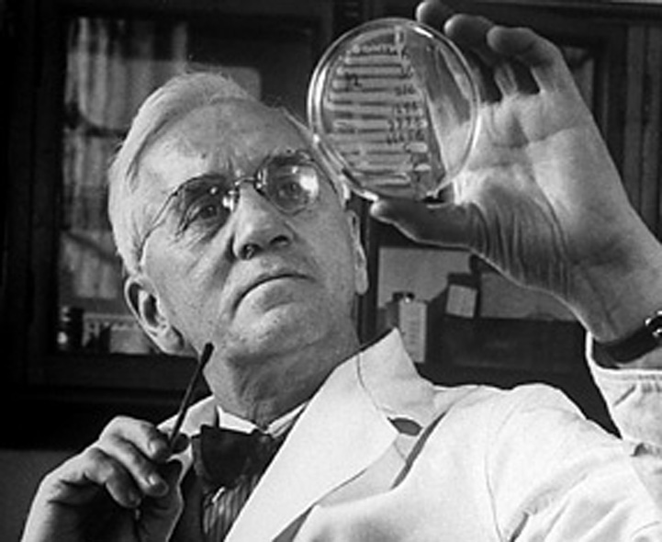
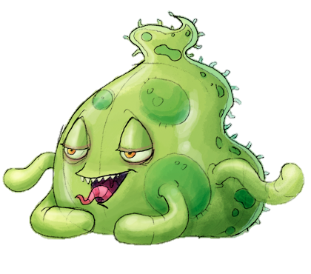
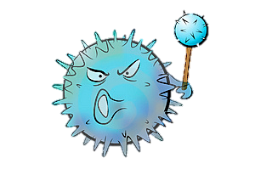
Antibiotics
Antibiotics were first discovered by Alexander Fleming in 1928, he called his discovery Penicillin.
We now have lots of different types of antibiotics that deal with bacteria in slightly different ways.
How would you kill a bacteria?
Antibiotics only kill or stop bacteria – NOT viruses.
Harsh days!

Slide 28
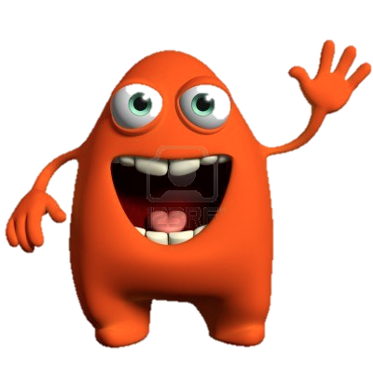
Antibiotic Facts
Antibiotic Animals
Antibiotics are designed to only target and destroy foreign bacteria in the body.
Antibiotics must be taken for the duration that your GP prescribes.
Antibiotics do not ease the symptoms but they kill the symptom causing pathogen.
If you stop taking antibiotics you may find the bacteria is still in your system and can regrow rapidly, sometimes mutating.
Mutant bacteria can become resistant to antibiotics.
antibiotic | how it works
penicillin | breaks down cell walls
erythromycin | stops protein synthesis
neomycin | stops protein synthesis
vancomycin | stops protein synthesis
ciprofloxacin | stops DNA replication

Slide 29
Task
There is an outbreak of MRSA at Kings College Hospital! You have been asked to explain to patients what MRSA is and how they can prevent it from spreading.
You can present your information in any way you chose and it will be peer assessed next lesson.
You will complete your task for homework and it is due on Monday 20th May.
THE HANDOUTS ARE THERE TO HELP YOU
– NOT TO COPY!

Slide 30
MRSA Information Sheet
MRSA is a type of bacterial infection that is resistant to a number of widely used antibiotics. This means it can be more difficult to treat than other bacterial infections.
The full name of MRSA is methicillin-resistant staphylococcus aureus. You may have heard it called a superbug.
Staphylococcus aureus (also known as staph) is a common type of bacteria. It is often carried on the skin, inside the nostrils and the throat and can cause mild infections of the skin, such as boils and impetigo.
If staph bacteria get into a break in the skin, they can cause life-threatening infections, such as blood poisoning or endocarditis (an infection of the inner lining of the heart).
How bacteria become resistant to antibiotics
Antibiotic resistance can occur in several ways.
Strains of bacteria can mutate and over time become resistant to a specific antibiotics.
Alternatively, if you are treated with an antibiotic, it can destroy many of the harmless strains of bacteria that live in and on the body. This allows resistant bacteria to quickly multiply and take their place.
The overuse of antibiotics in recent years has played a major part in antibiotic resistance. This includes using antibiotics to treat minor conditions that would have got better anyway or not finishing a recommended course of antibiotics.
How do you get MRSA?
MRSA infections are more common in people who are in hospital or nursing homes. Doctors often refer to this as healthcare-associated MRSA (or HA-MRSA).
Hospital patients are more at risk because:
They often have an entry point for the bacteria to get into their body, such as a surgical wound, burn or a intravenous drip (a tube used to give fluids directly into a vein).
They are usually older and weaker, which makes them more vulnerable to infection.
They are surrounded by a large number of people, which means bacteria can easily spread through direct contact with other patients or staff or contaminated surfaces.
More recently, MRSA has been known to develop outside hospitals and nursing homes. This is known as community-associated MRSA (or CA-MRSA). It is more common in crowded environments where there is frequent skin-to-skin contact and hygiene is poor, such as homeless shelters or army bases.

