Slide 2
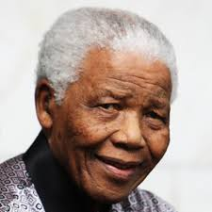
Nelson Mandela
This is an opportunity to reflect on his life and legacy, and to recognise his call to
“make of the world a better place.”

Slide 3
Nelson Mandela is seen as one of history's most inspirational figures.
He spent 67 years of his life striving to achieve human rights and a better future for everyone in South Africa.

Slide 4
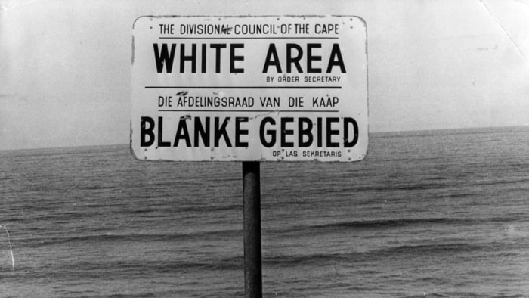
Apartheid is an Afrikaans word meaning “the state of being apart.”
When Nelson Mandela was a young man, white and black people in South Africa were segregated from each other as part of the Apartheid system.
Notes:
White people, who were a small part of the population, were in charge of the country.
It was illegal for black people to use the same schools, hospitals, and even beaches as white people. Conditions in whites-only schools and hospitals were much better.
Black people were also denied basic rights - like being allowed to vote in elections.

Slide 5
1948 – 1994
Life in Apartheid-Era South Africa:
People of colour must carry identification papers at all times
Black people were not allowed to go to certain places (restricted movement)
People of colour were forced to live in certain places; they had no choice where to live.
Black people could not marry white people
Education was restricted for black children

Slide 6
1948 – 1994
Life in Apartheid-Era South Africa:
Everywhere from hospitals to beaches to benches were segregated
Black people could not set up businesses in ‘white’ areas
Highly skilled, better paid work was only for white people
Black people could not marry white people
A registration was set up so the government could classify people according to their race

Slide 7
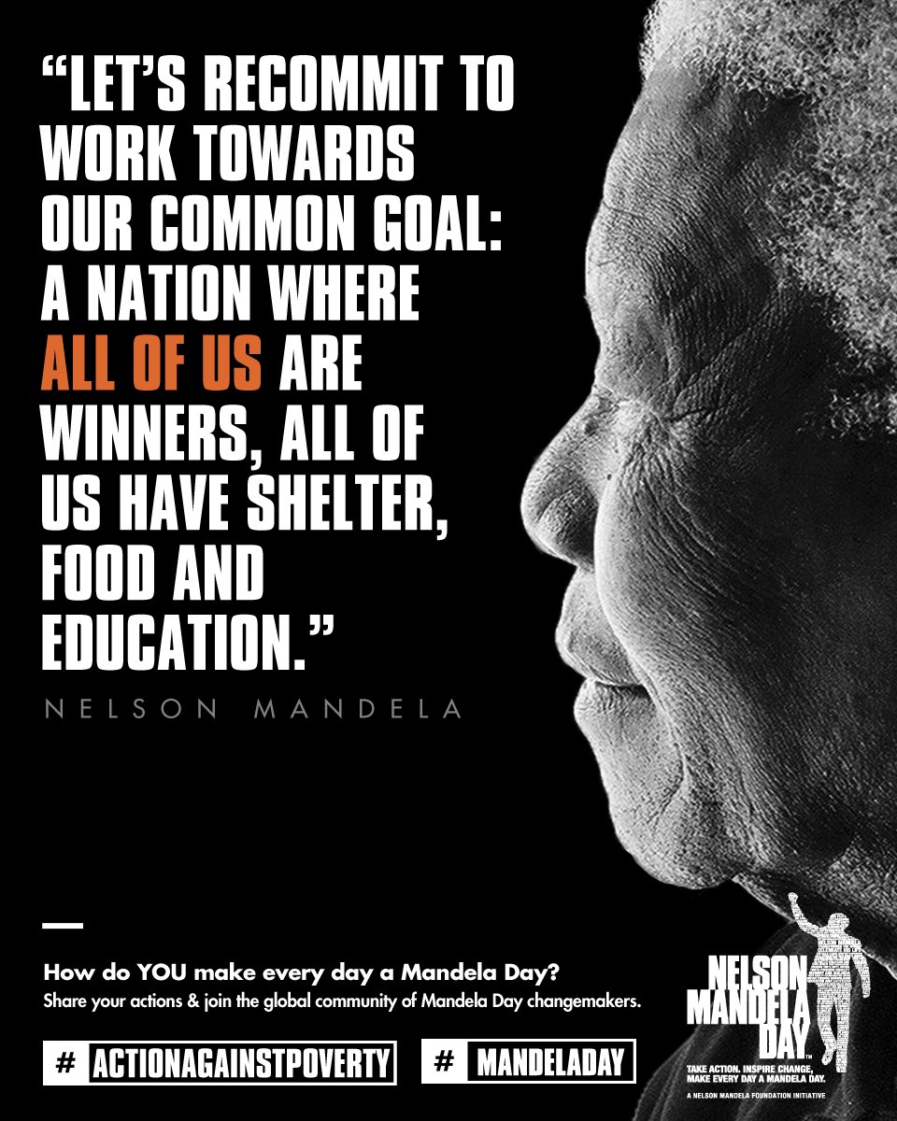
Nelson Mandela didn’t agree with apartheid. He believed that everybody should be treated equally. Everyone should have access to the same healthcare, education, access to food and homes.
Notes:
In 1944, Nelson Mandela joined the African National Congress, a group that wanted black South Africans to have the same human rights as whites.
Mandela led young people in the African National Congress. Many people, both black and white, spoke out against apartheid.

Slide 8
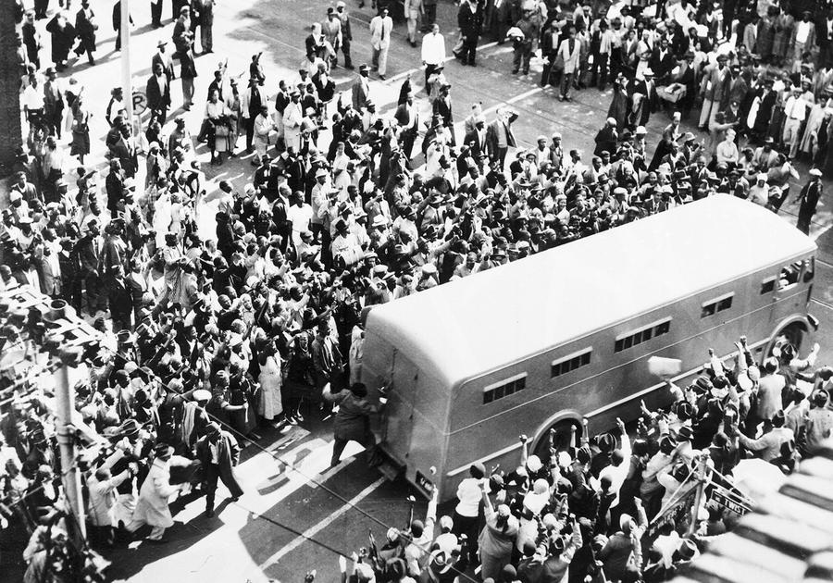
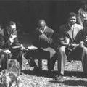
Speaking out against the government (and apartheid) at this time was dangerous. In 1956, Mandela and 155 other people were arrested for treason. After a trial lasting five years, he was set free in 1961.
https://www.bbc.com/education/clips/zb93cdm
Notes:
The first photo shows the prisoners being taken into the treason trial with crowds shouting around them.
The second shows Mandela and his co-accused during a break.

Slide 9
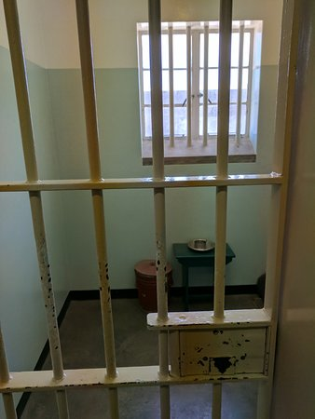
A year later, Mandela was accused of sabotage and plotting to overthrow the government. He was arrested and in 1964 was sentenced to life in prison on Robben Island. During his time in prison, photos of him were banned and it was even illegal to quote him in public.
.

Slide 10
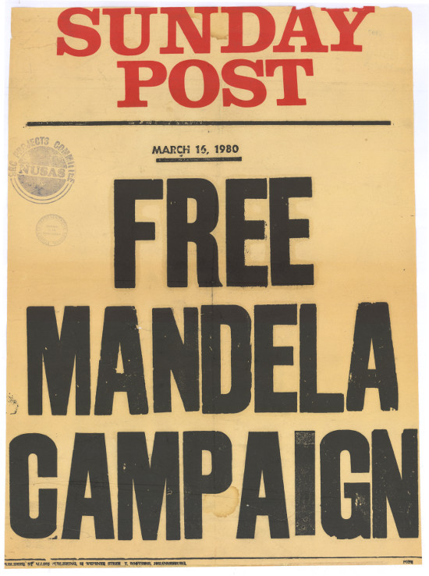
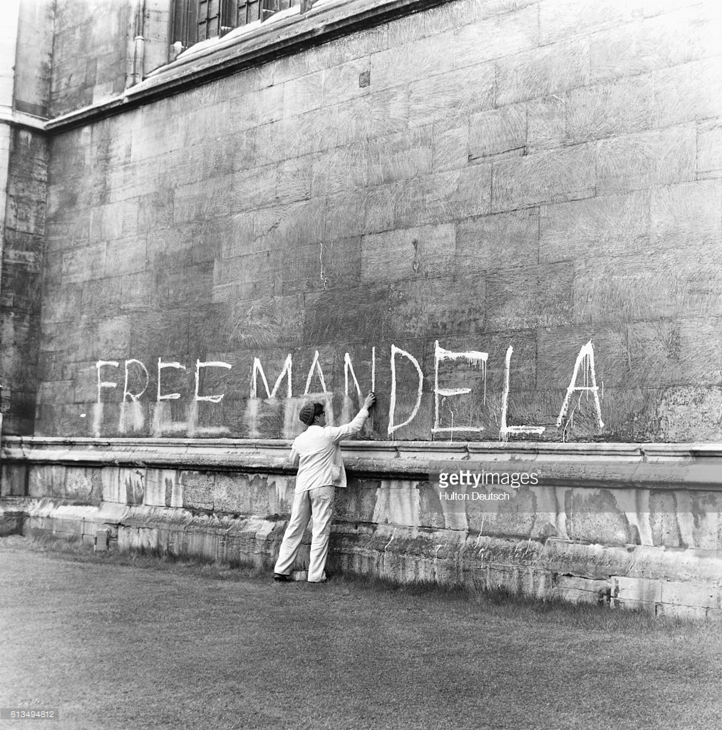
During his time in prison, people in South Africa (and across the world) campaigned for his release.
Notes:
The picture shows ‘Free Mandela’ spray painted on the wall (and being washed off) Kings College, Cambridge in 1964.

Slide 11
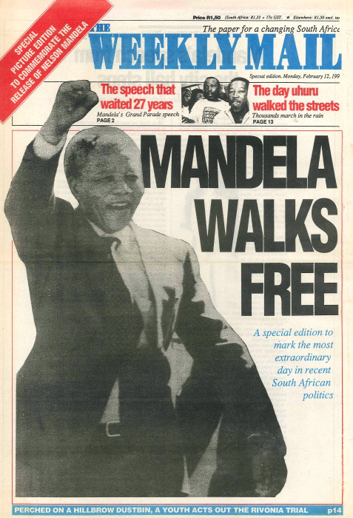
In 1990, South Africa's new President FW de Klerk set Nelson Mandela free.
Mandela called on all South Africans to work together in peace.

Slide 12
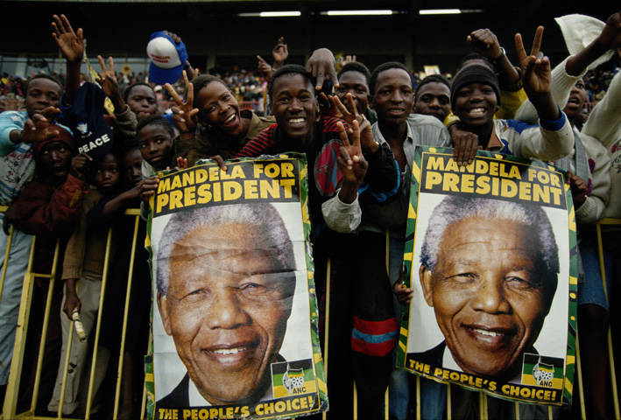
In 1991, Mandela became leader of the ANC. In the 1994 elections, all black people in South Africa were able to vote for the first time.
The ANC won the election and in May 1994 Nelson Mandela became South Africa's first black president.

Slide 13
Nelson Mandela followed three rules throughout his life, which he did at great personal sacrifice:
Free yourself
Free others
Serve every day
He spent 67 years serving the community of South Africa.

Slide 14
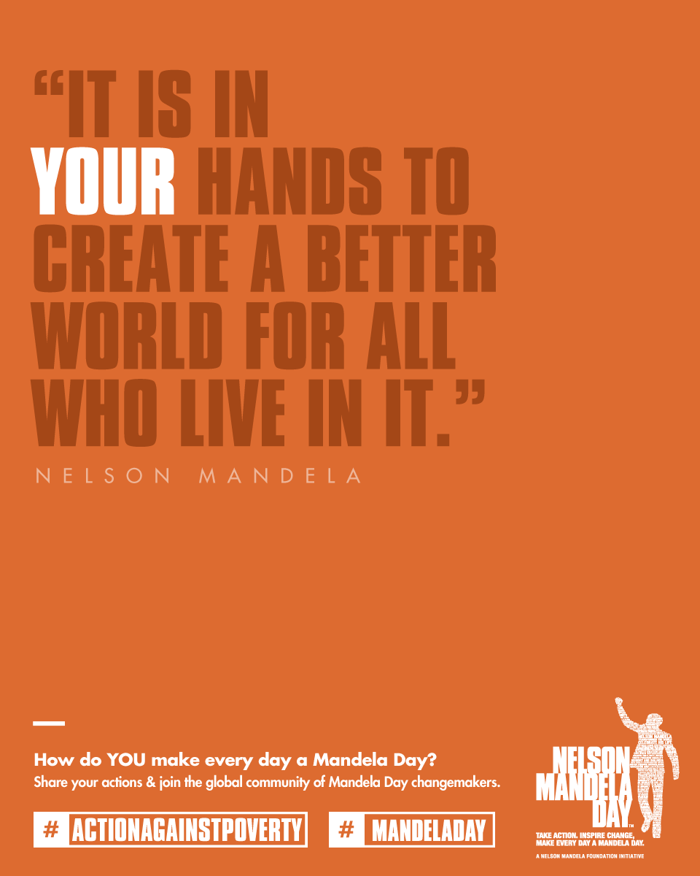
The Nelson Mandela Foundation are asking that the people get involved with Mandela day by devoting 67 minutes of their time to helping to make the world or their local environment a better place.

Slide 15
Everyone has the ability and the responsibility to change the world for the better.
No matter how small your action, Mandela Day is about changing the world for the better, just as Nelson Mandela did every day.

Slide 16
18th July 2020

