Slide 2
Hello! I’m Ms Fox. My class have been learning about counting to 20. Can you count to 20? Can you help the children in my class work out the missing numbers?

Slide 3
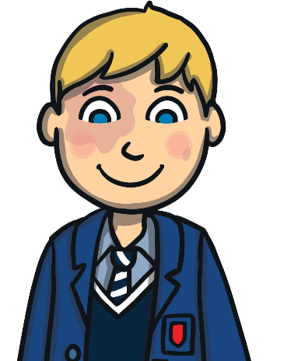
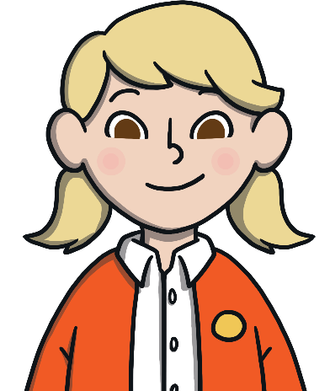
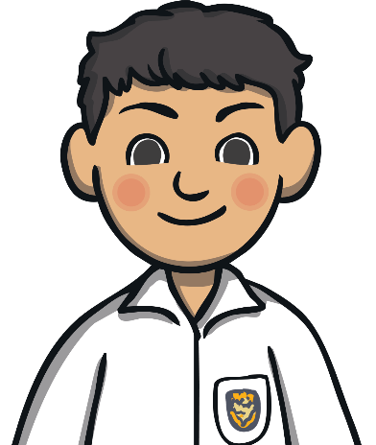

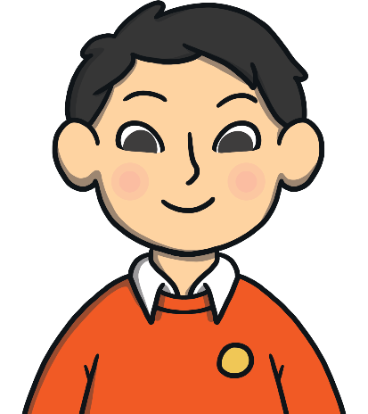
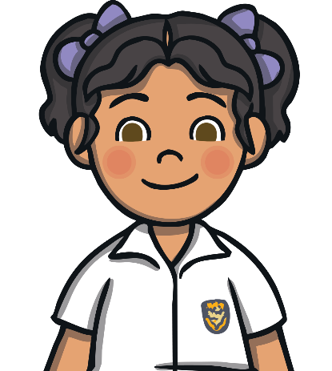
7
8
9
10
11
12
14
18
Can you help my class work out the missing number?
Try again.
Try again.

Slide 4


7
8
9
10
11
12
What number did you say next? Why did you think it was that number?

Slide 5
11
12
13
14
16
12
15
17
Can you help my class work out the missing number?
Try again.
Try again.

Slide 6
11
12
13
14
15
16
What number was missing? How did you know?

Slide 7
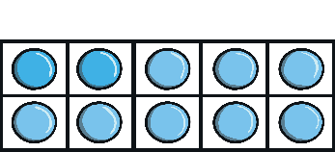
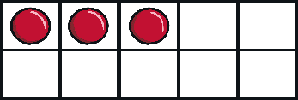
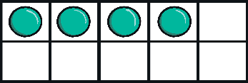
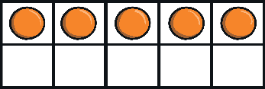
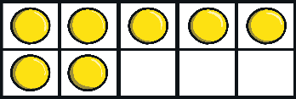
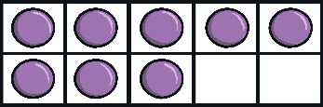
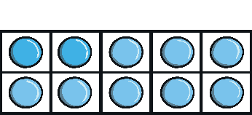
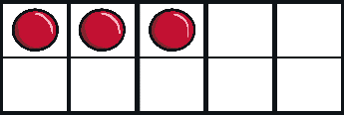
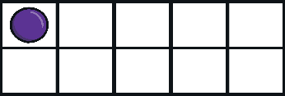
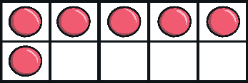
13
14
15
17
18
13
11
16
Try again.
Can you help my class work out the missing number?
Try again.

Slide 8
13
14
15
16
17
18
What number was missing? Can you tell me what number came before 16?

Slide 9







10
11
12
14
15
13
11
16
Can you help my class work out the missing number?
Try again.
Try again.

Slide 10
10
11
12
13
14
15
What was the missing number? Can you tell a friend how you worked it out?

Slide 11
14
15
16
18
19
11
17
20
Try again.
Can you help my class work out the missing number?
Try again.

Slide 12
14
15
16
17
18
19
What was the missing number? Can you work with a partner to show the missing number on your fingers?

Slide 13
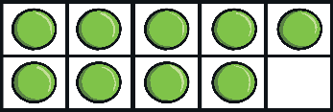
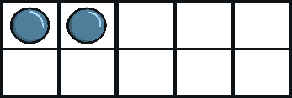
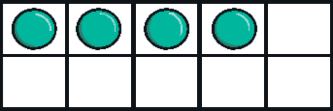
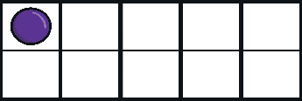
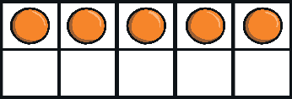
9
10
12
13
14
11
15
16
Can you help my class work out the missing number?
Try again.
Try again.

Slide 14
9
10
11
12
13
14
What was the missing number? What would the next number in the sequence be? Why?

Slide 15



15
16
17
18
19
12
14
20
Try again.
Can you help my class work out the missing number?
Try again.

Slide 16





15
16
17
18
19
20
What number was missing? Can you tell me what you think the next number after 20 will be?

Slide 17
Thank you for helping my class with their counting!

