Slide 2
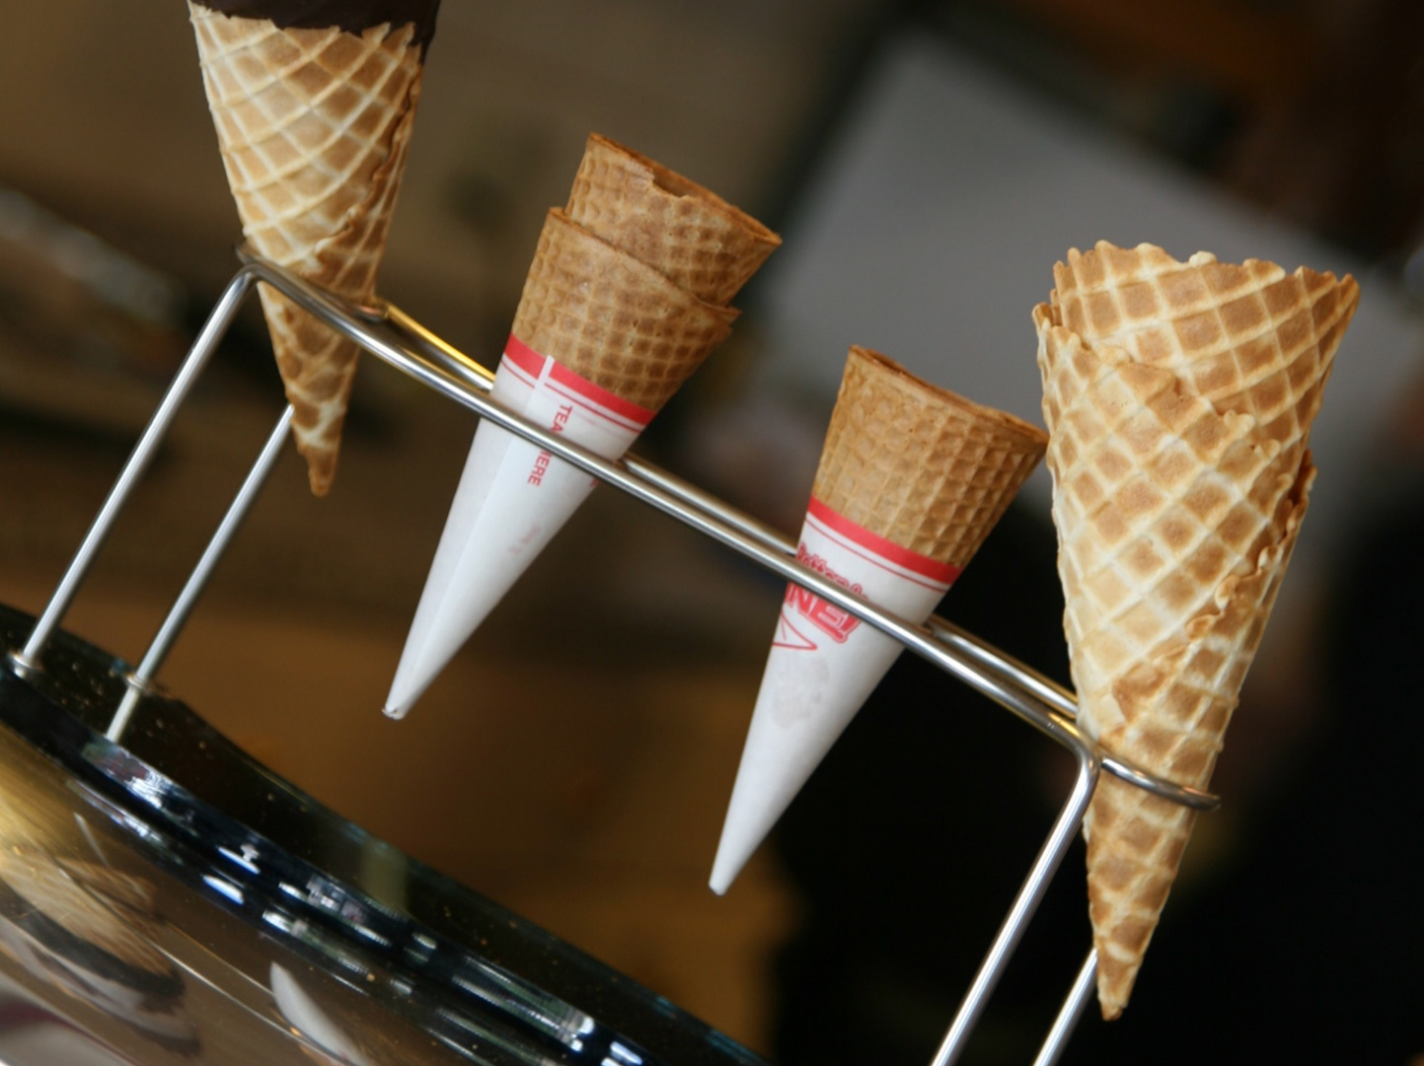
cone
Reveal

Slide 3
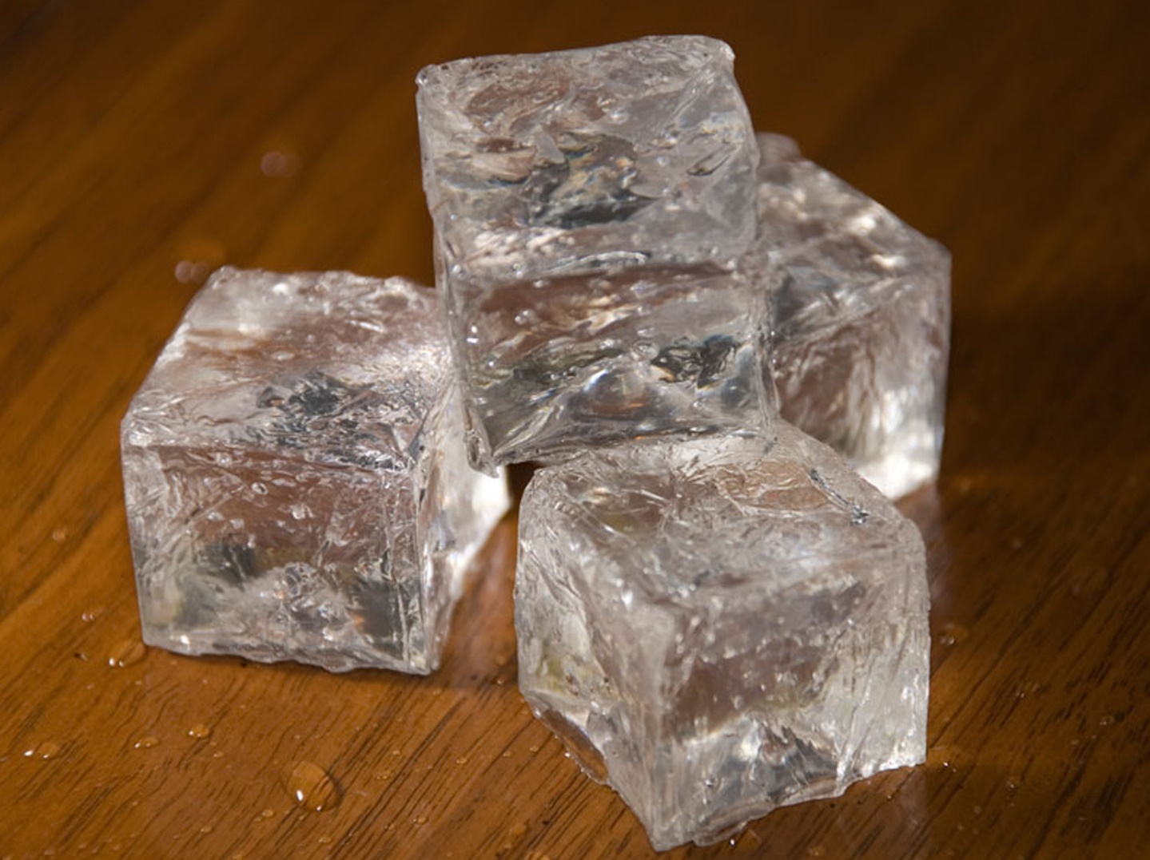
cube
Reveal

Slide 4
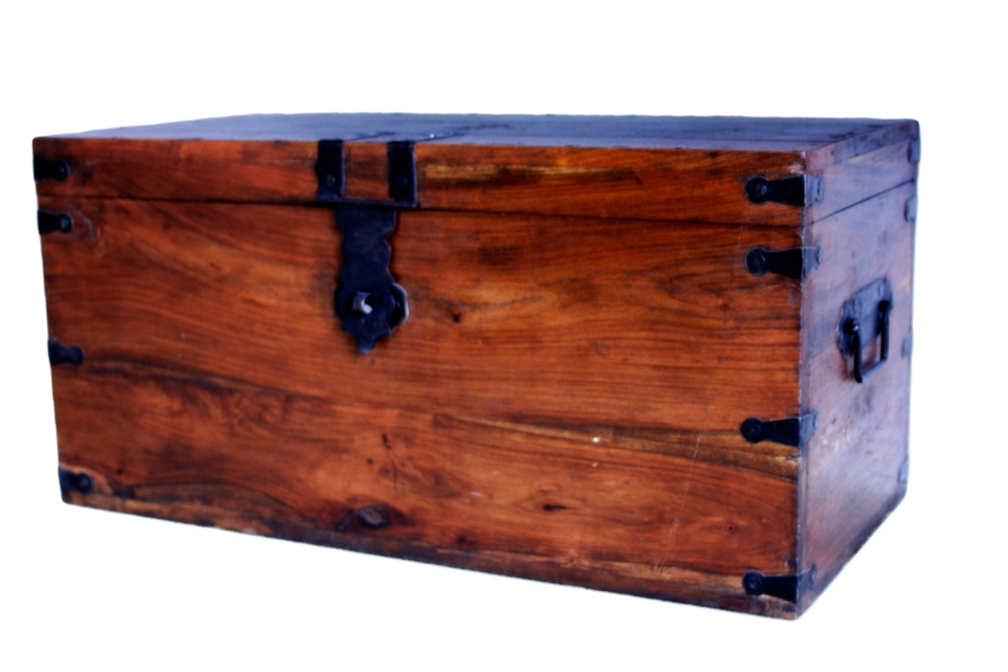
cuboid
Reveal

Slide 5
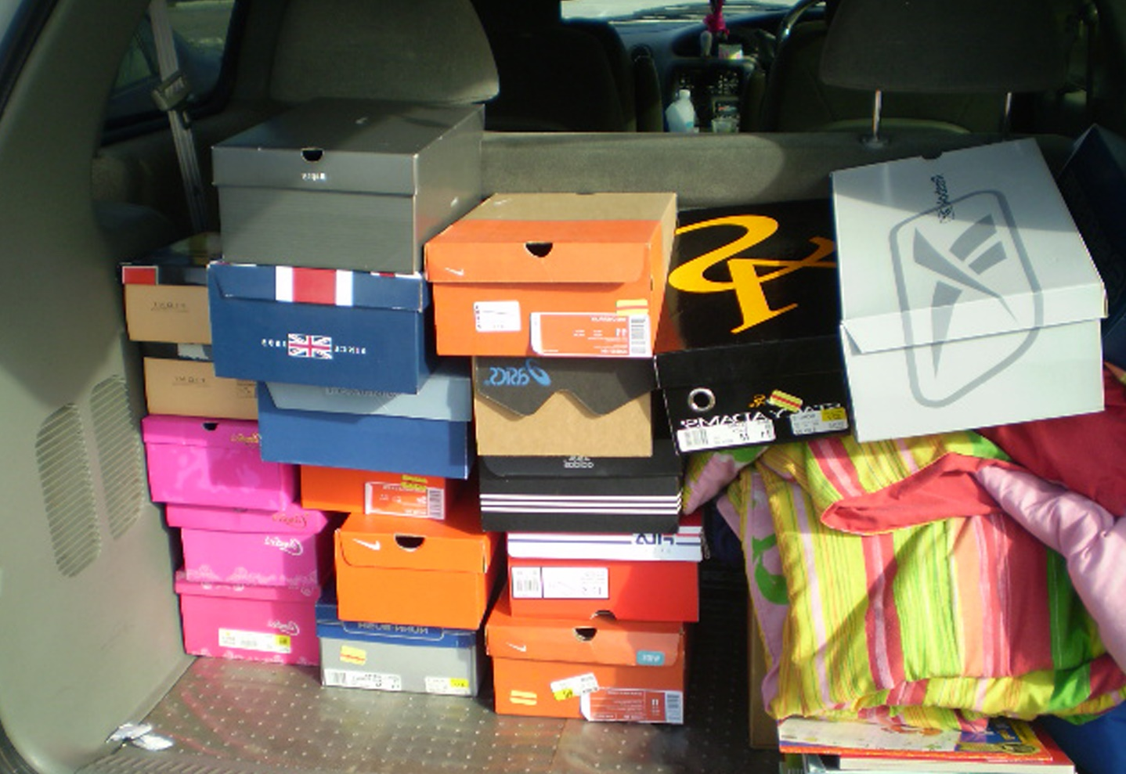
rectangular prism
Reveal

Slide 6
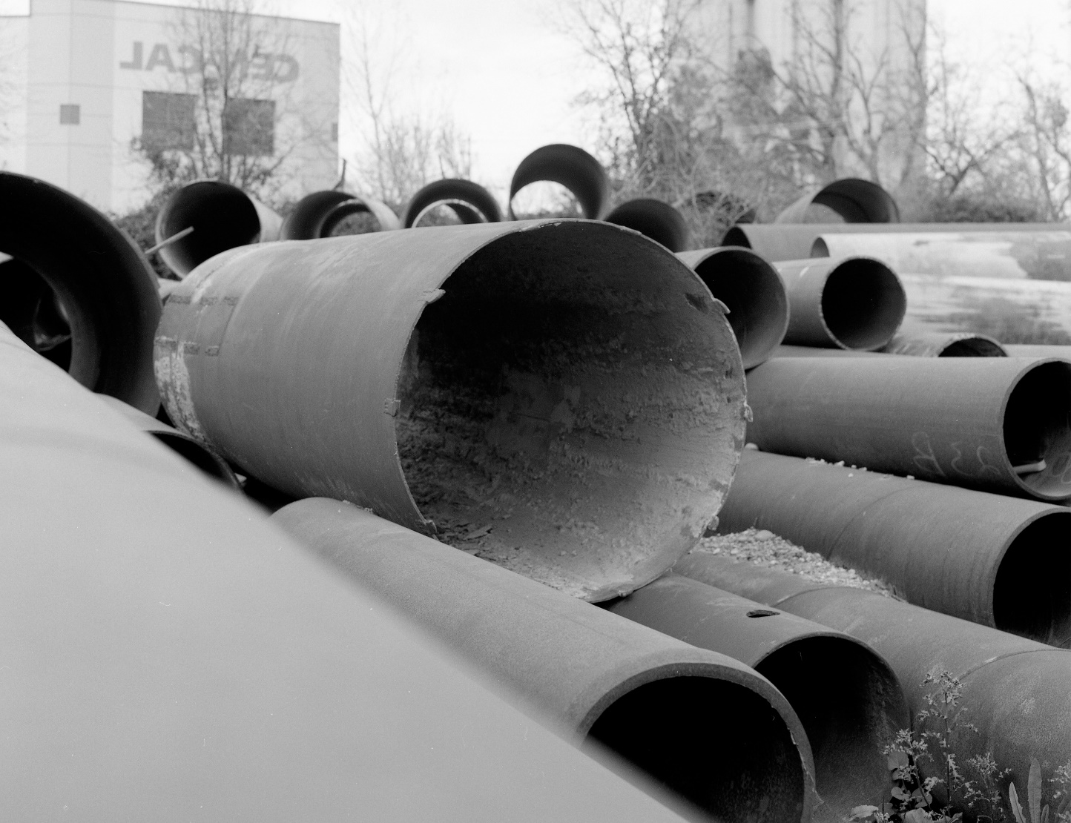
cylinder
Reveal

Slide 7
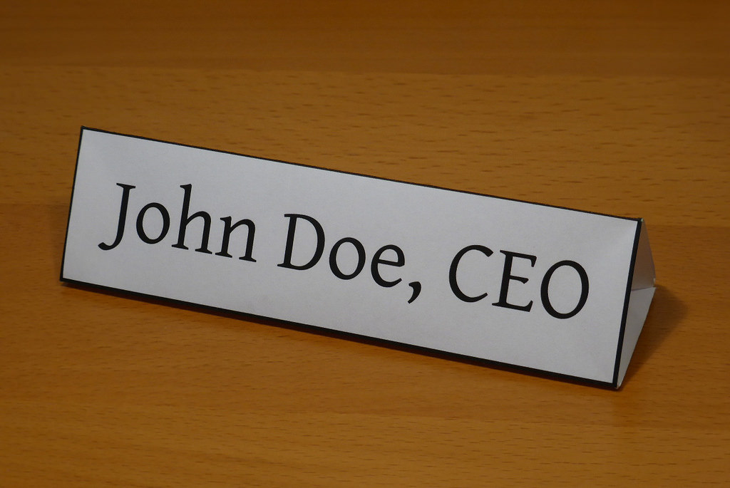
triangular prism
Reveal

Slide 8
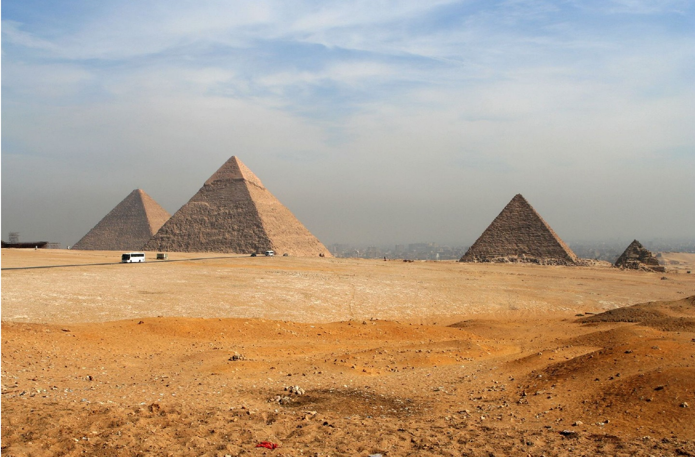
pyramid
Reveal

Slide 9
sphere
Reveal

